Slide 1
DATA SCIENCE FOR ECONOMISTS
ECON 220 LAB
Jafet Baca-Obando
Week 2, Introduction to Python (I) – 09/05/2025

Slide 2
Outline
Setup
Loading data using Pandas, NumPy, and Matplotlib
Exploration and descriptive statistics
Basic visualization and data handling

Slide 3
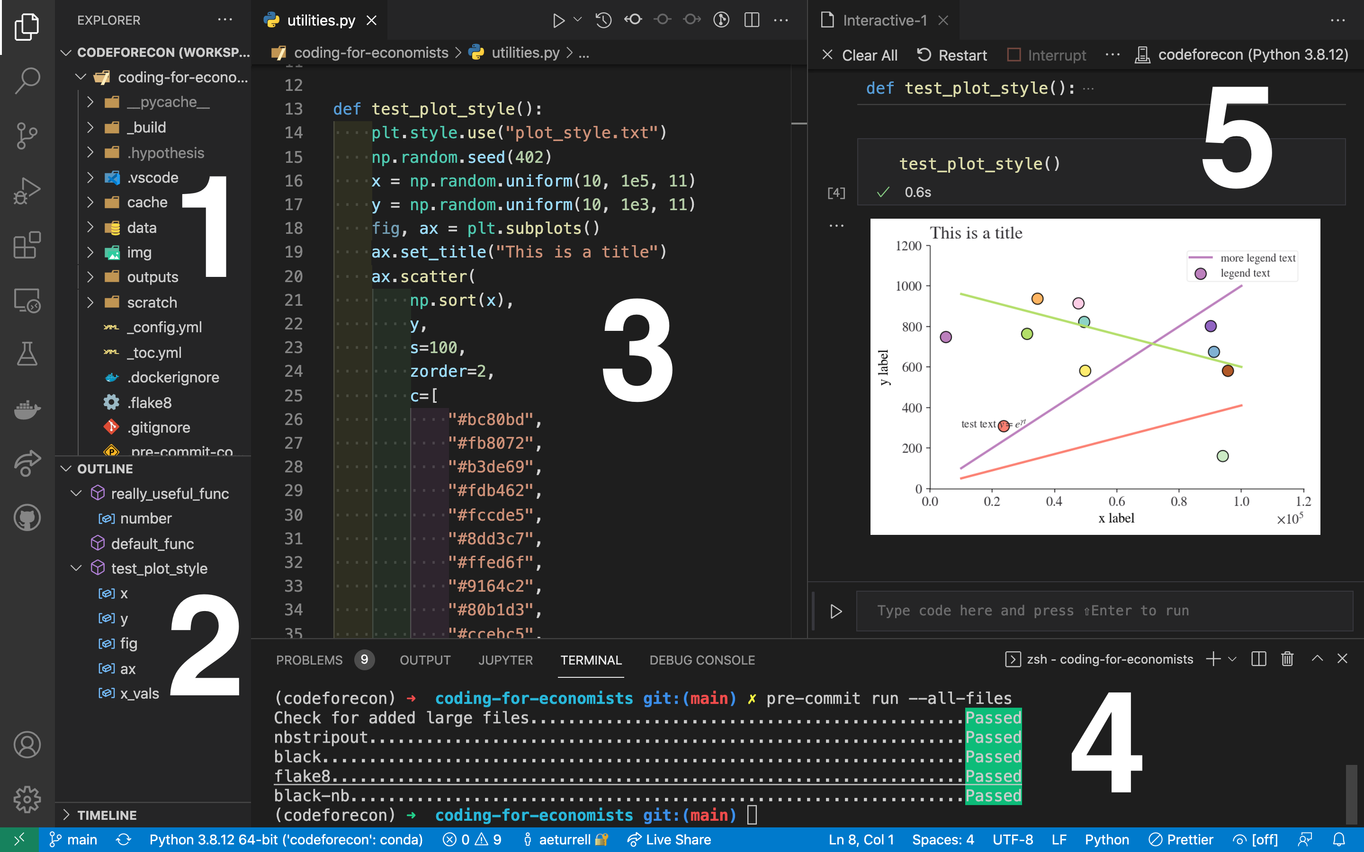
Typical layout of Visual Studio Code

Slide 4
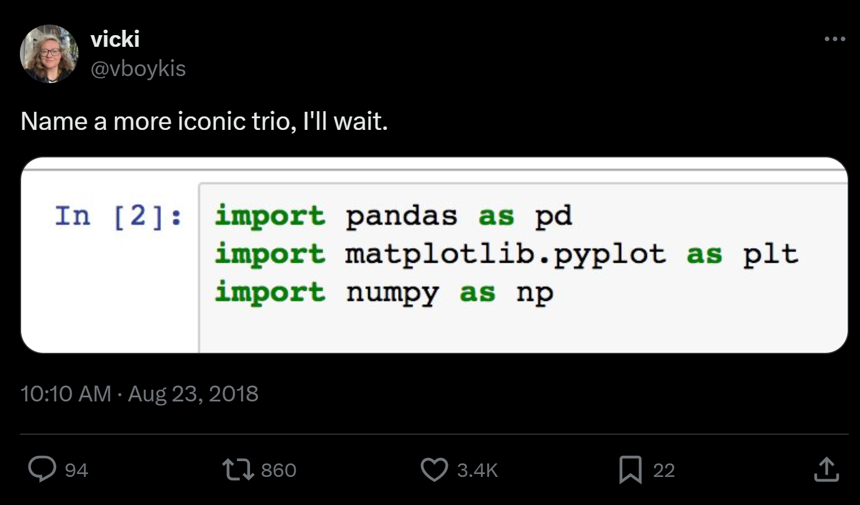
The economist’s Python toolkit
Pandas
  Data manipulation and analysis (loading, cleaning, exporting, etc.)
NumPy
  Numerical computation (average, sum, median, etc.)
Matplotlib
  Visualization

Slide 5
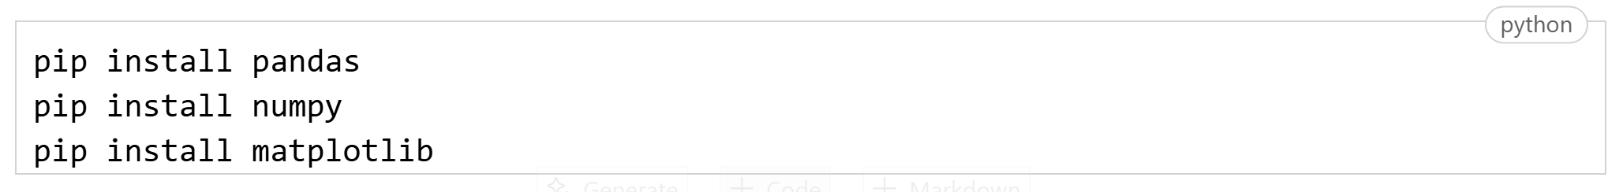
Installation
Python packages don’t come built-in
  We need to install them (just once)
  And then import them into our scripts
Notes
  Download Jupyter Notebook in the VS code extensions
  VS Code might require you to install Ipykernel. Allow it to do so

Slide 6
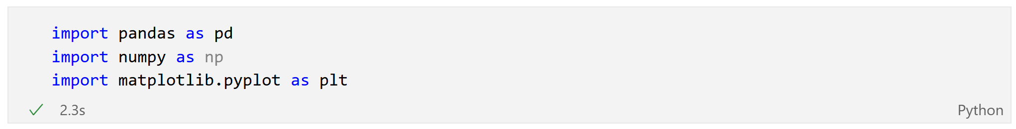
Loading the packages into the workspace
Import the necessary libraries

Slide 7
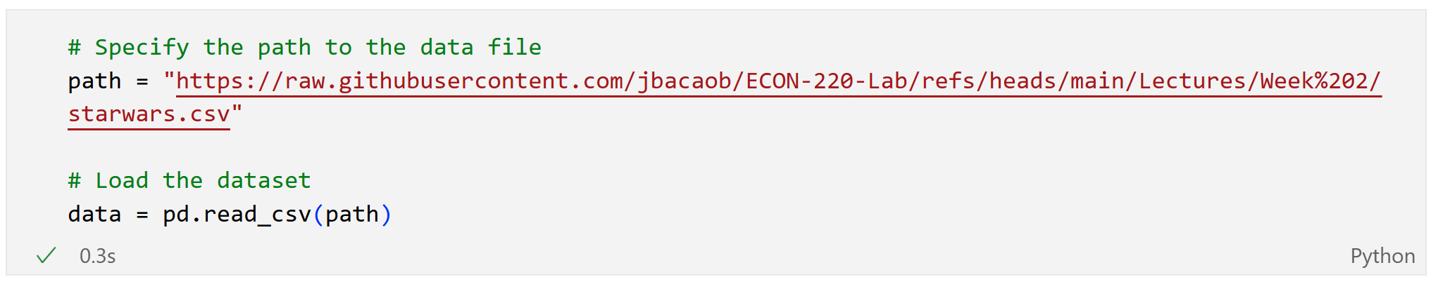
Loading a dataset
Use Pandas to load a CSV file directly from a URL.
The data is loaded into a DataFrame, the central data structure in Pandas.
Like an Excel spreadsheet

Slide 8
First look: .head() and .tail()
How do you get a quick overview of the data without printing the entire DataFrame?
  data.head(n): Shows the n first rows
  data.tail(n): Shows the last n rows

Slide 9
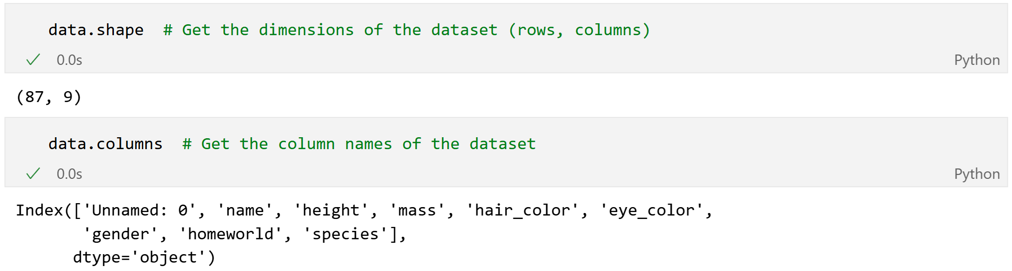
Exploring the DataFrame’s structure
Before analysis, understand the dataset's dimensions and data types
  .shape: Returns a tuple representing the dimensions (rows, columns).
  .columns: Returns the list of column names.
  .dtypes: Returns the data type of each column (object usually means string, float64 is a float, int64 is an integer).

Slide 10
Scales of measurement
Categorical
  Places data into distinct groups or labels.
  Nominal: Categories with no natural order (for example, homeworld)
  Ordinal: Categories with a meaningful order (for example, income groups: low, medium, high)
Interval: Variable with fixed increments (temperature, grades)
Ratio/continuous: Changing increments (height, weight)

Slide 11
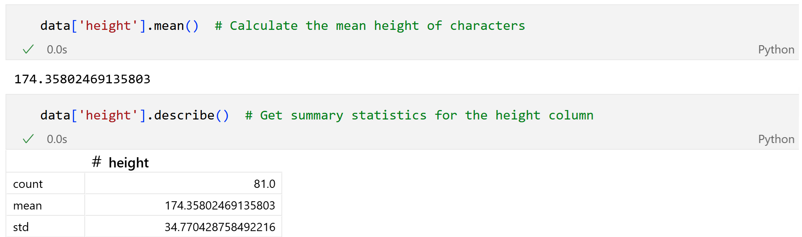
Descriptive statistics: numerical data
For continuous (or ratio) variables like height, we can easily calculate summary statistics.
  .mean(): Calculates the average.
  .describe(): Provides a full summary (count, mean, standard deviation, min, max).

Slide 12
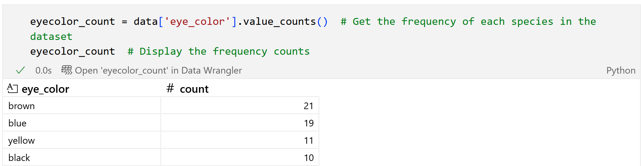
Analyzing categorical data
We’re often interested in the frequency of each category.
.value_counts(): Returns a series containing counts of unique values.

Slide 13
Basics of data visualization
A picture is worth a thousand words.
Tables of numbers are useful, but visualizations are essential for:
  Quickly identifying patterns, trends, and outliers (extreme values)
  Communicating findings effectively
We will use matplotlib to create our first plots.

Slide 14
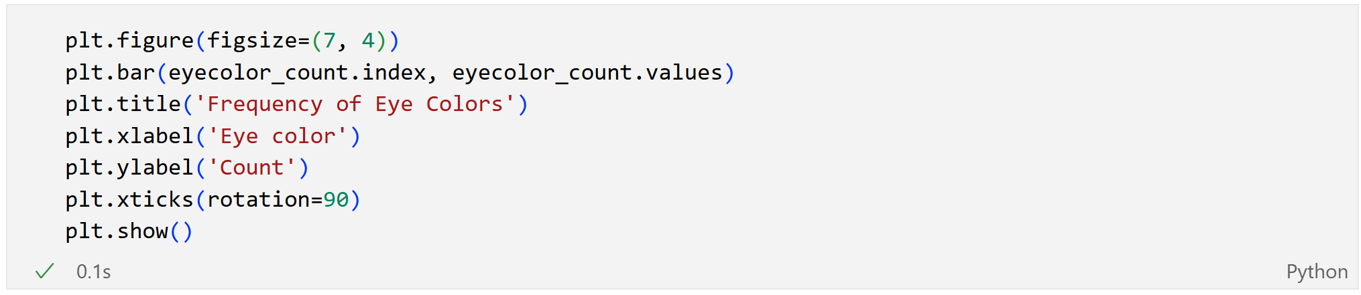
Visualizing frequencies: bar chart
A bar chart is excellent for visualizing the frequency counts of categorical data.

Slide 15
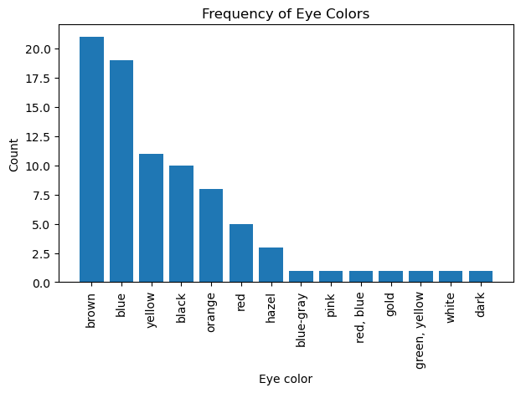
Visualizing frequencies: bar chart

Slide 16
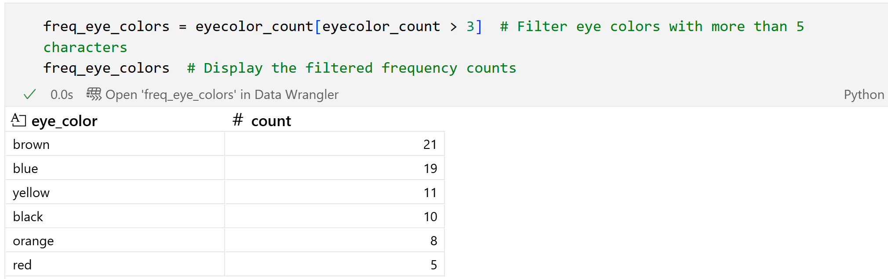
Handling data: filtering
We may want to analyze a subset of your data.
Filter a DataFrame by passing a condition inside square brackets [ ].
  Let's filter for eye colors that appear for more than 3 characters.

Slide 17
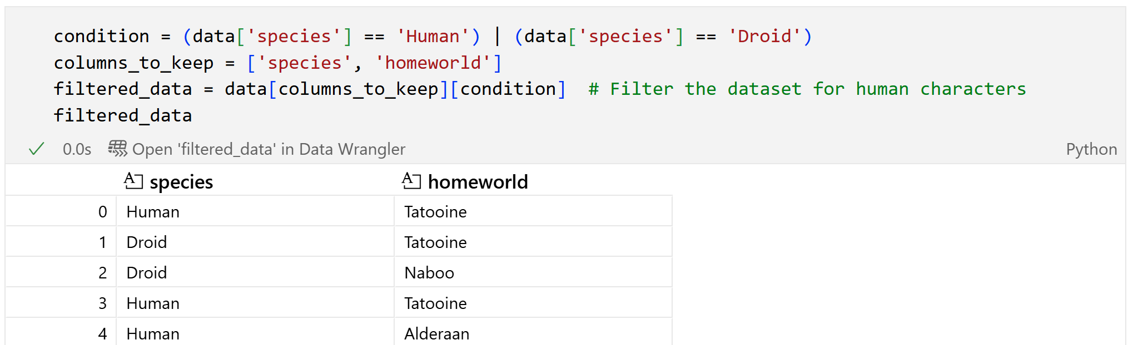
Subsetting rows and columns
Indexing + column selection to create more complex subsets.
Goal: Find the homeworld of all 'Human' or 'Droid' characters.
  | is the "OR" operator, & is the "AND" operator.

Slide 18
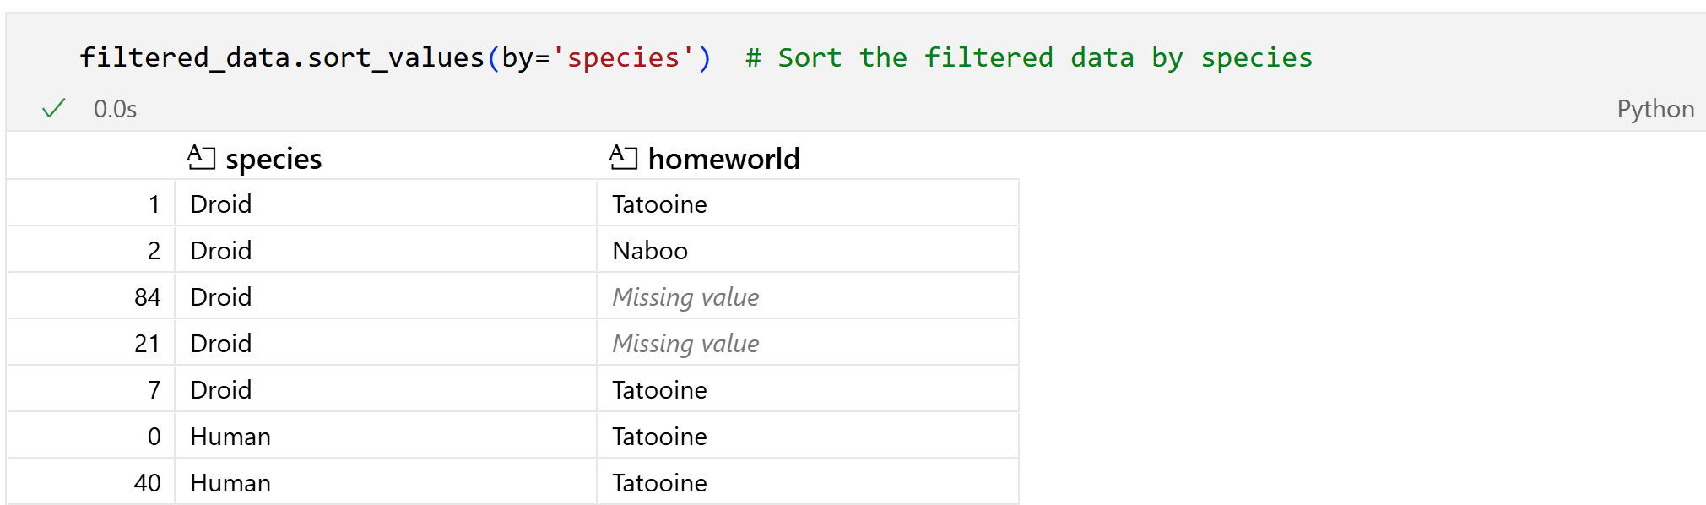
Sorting data
Sorting your data makes it easier to inspect.
.sort_values(by='column_name'): Sorts the DataFrame by the specified column.

Slide 19
Recap
We loaded essential libraries (pandas, matplotlib).
Imported data into a DataFrame.
Explored its structure and computed summary statistics.
Created basic visualizations.
Subset and sorted the data based on conditions.

Slide 20
To-do list
DataCamp
  Complete “Introduction to Python” course
  Upload certificate on Canvas: 09/06/2025
  Complete “Intermediate Python” course
  Upload certificate on Canvas: 09/13/2025

Slide 21
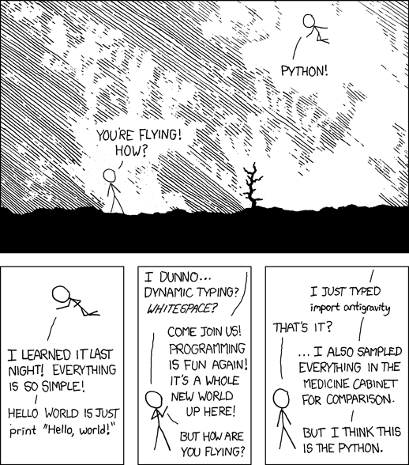
Python, from xkcd.

